Slide 1
Border design
technique

Slide 2
How to make?

Slide 3
There are four sides in the design. In border design two sides are variable and the other parallel two are constant.
The two variable sides join in such a way that it create continuity in the motif and create a border design.

Slide 4
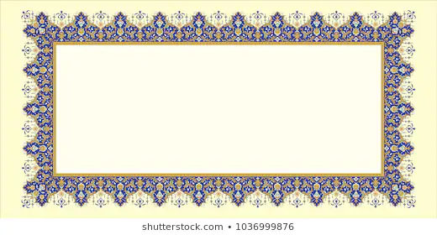

Slide 5
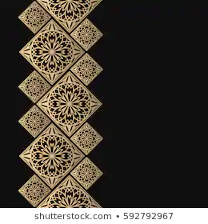

Slide 6
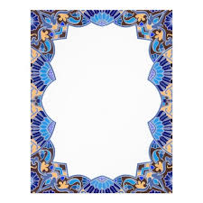

Slide 7


Slide 8
